Slide 1
Demystifying Process Injection and other Malware Tactics
September 29, 2023

Slide 2




Leo Bastidas
Scott Nusbaum
Principal Incident Response Consultant
@cyberGoatPsyOps
Principal Research Analyst
@_snus

Slide 3
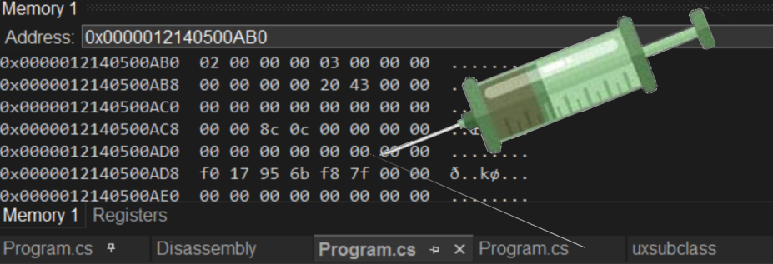
Overview
Parent Process ID Spoofing + Process Hollowing
DLL Hollowing
Reflective DLL Injection
DLL Injection SetWindowsHookExA
Thread Queue APC Injection (Syscall Example)
Shellcode Injection using Mapping Sections
API Hooking + Hooking IAT
API Hashing

Slide 4
Visit our Blog Series
https://www.trustedsec.com/blog/

Slide 5
Github with Research Code
https://github.com/trustedsec/TCS_InjectionTechniques

Slide 6
PPID + Process Hollowing

Slide 7
Overview of Process Hollowing
Parent Process ID Spoofing (PPID Spoofing)
Hiding the origins of the malicious process
Craft fake StartupInfo and pass as argument to CreateProcess
Now new process runs with the fake parent’s ID
Process Hollowing
Multiple ways to perform this task
Create a new Process in a SUSPENDED state
Parse the entry point from the newly created process
Overwrite the entry point with the shellcode
Resume process execution calling our injected shellcode

Slide 8
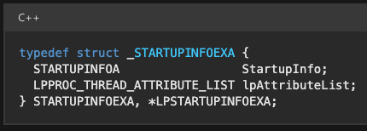
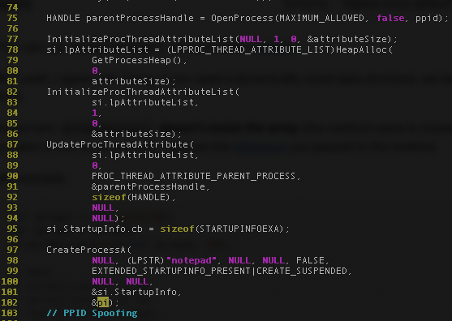
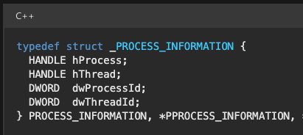
PPID Spoofing

Slide 9
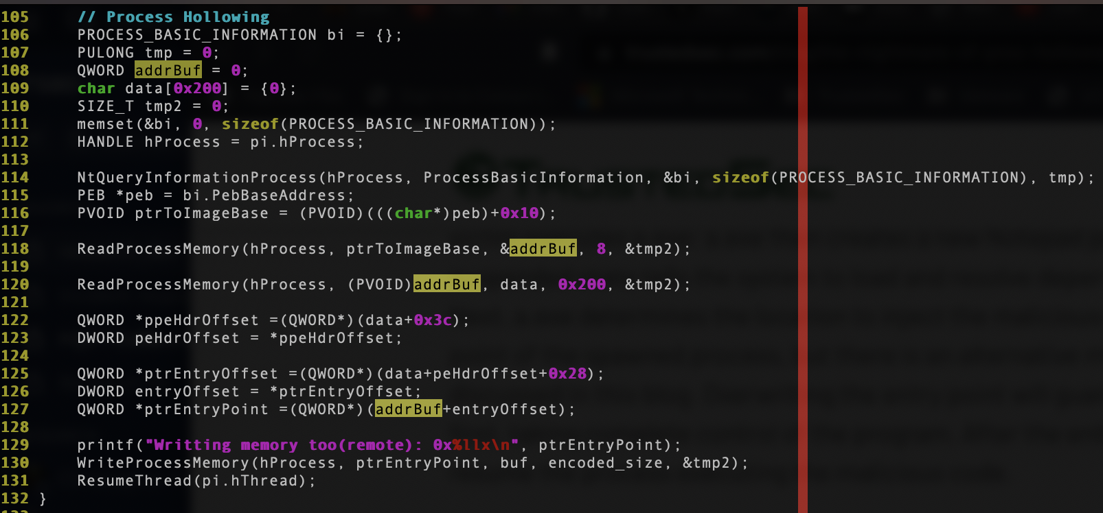
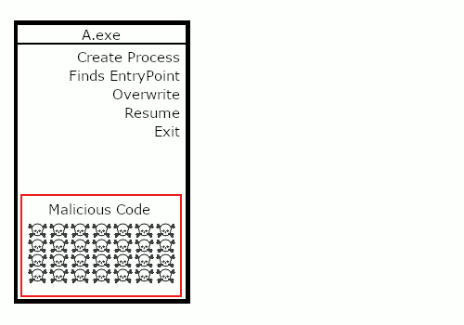
Process Hollowing

Slide 10
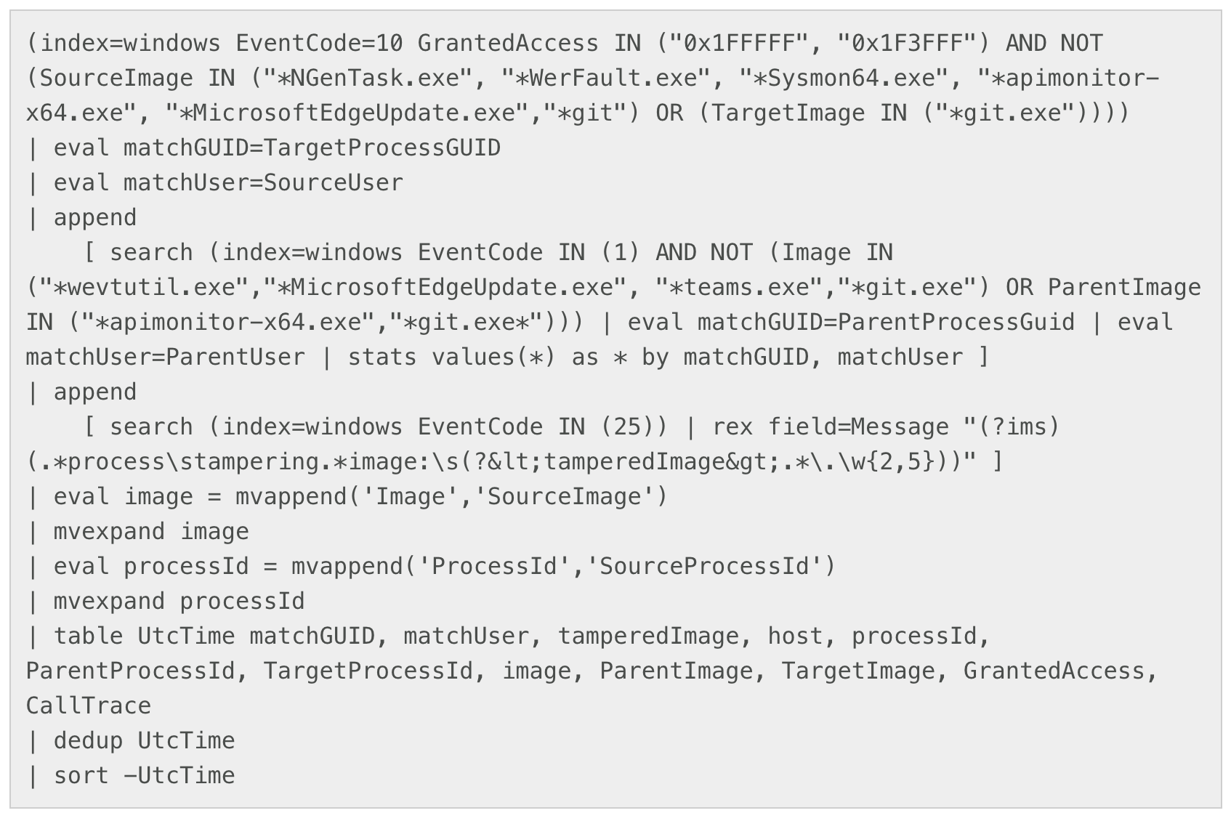
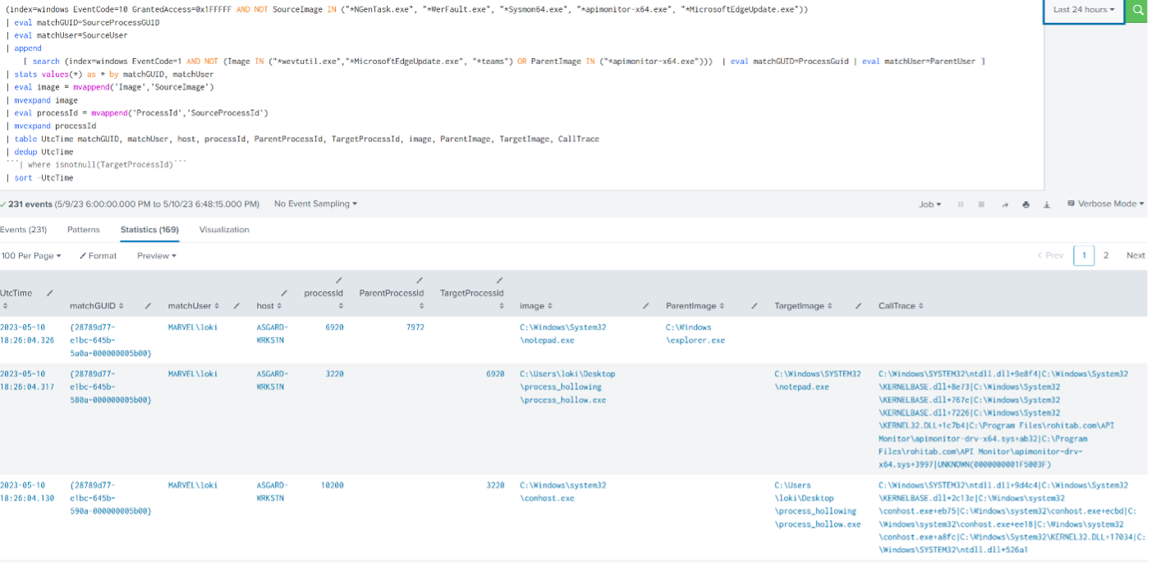
Proof of Concept Detection
Good ol’ Splunk

Slide 11
Query Breakdown
Aggregate Process Access events
Match GUIDs and USERs
Append to include Process Creation events
Also looks for File Tampering events (Sysmon Event ID 25)
Aggregate GUIDs and Users that match
Filter out results

Slide 12
What can defenders do?
Monitor process creation events for any anomalies.
Monitor or investigate any entry point changes that occur on the suspicious process.
Monitor or investigate memory allocation, such as malware using the WriteProcessMemory function to write data to a remote process
Monitoring and investigating parent-child relationships can be a good starting point for the initial investigation
Analyzing the process properties and behavior can help confirm the suspicious process of 'Hollowing'.

Slide 13
DLL Hollowing

Slide 14
Overview of DLL Hollowing
Steps for a basic DLL Hollowing in the current program
Use LoadLibrary to load any library that is not already loaded by the program
Parse the MZ/PE headers of the library to locate the EntryPoint
Copy shellcode over the entry point
Execute shellcode using CreateThread

Slide 15
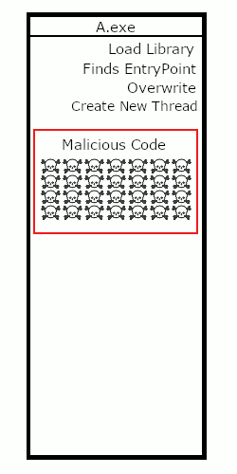
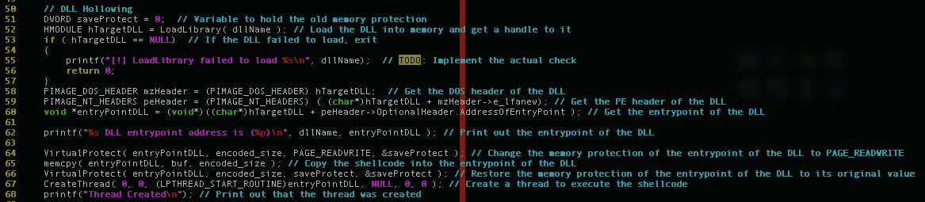
Code of DLL Hollowing

Slide 16
Detection of Injection
Entrypoint changes
Size
Address
Code changes
API calls
LoadLibrary
Memcpy/memset
VirtualProtect
CreateThread

Slide 17
What can defender do?
Monitor Process Behavior
Memory Analysis
API Monitoring
Check memory protection
Write or use signature-based detections
Look into heuristic analysis

Slide 18
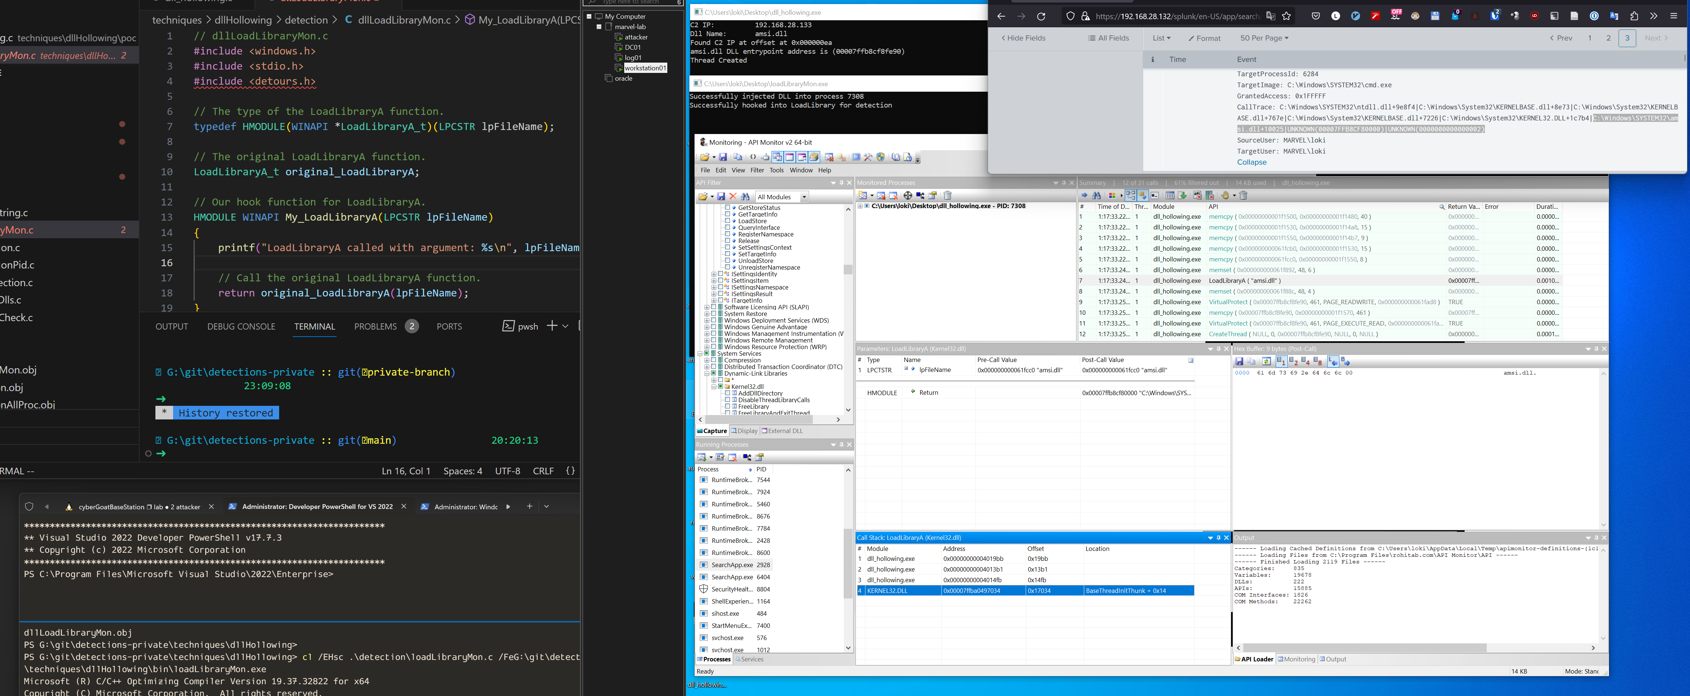
Proof of Concept Detection

Slide 19
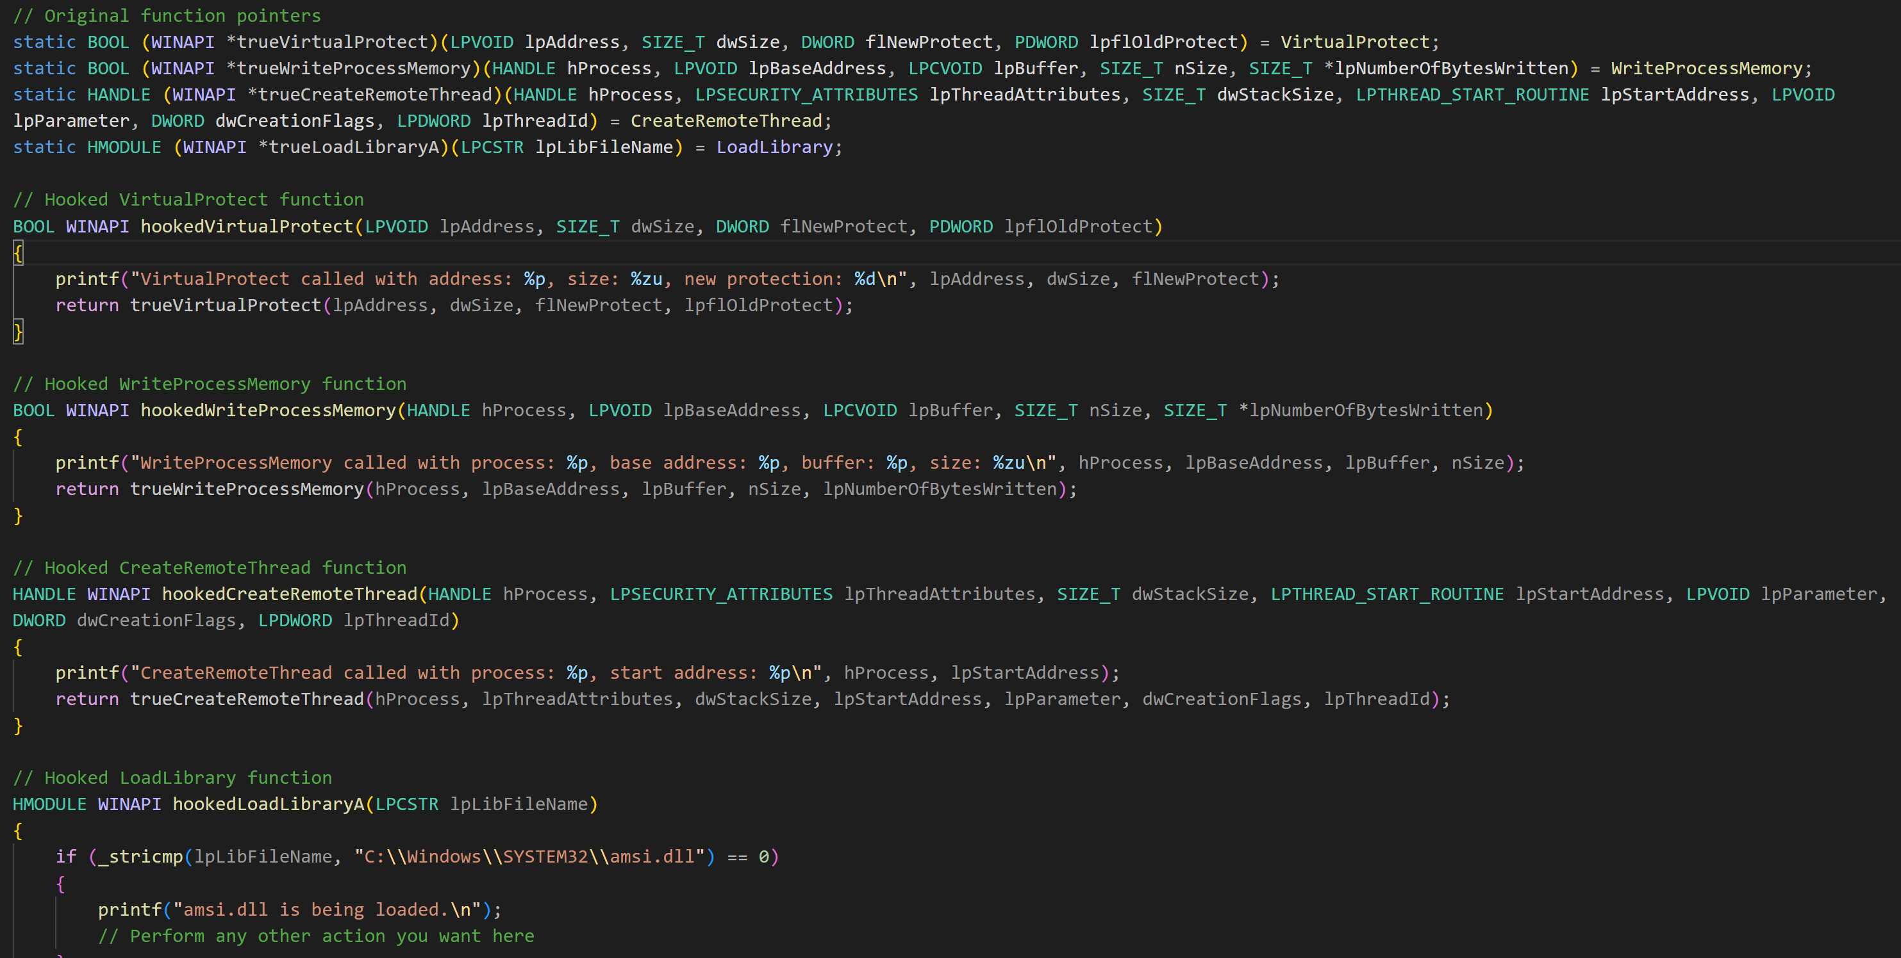
Proof of Concept Detection

Slide 20
Reflective DLL Injection

Slide 21
Overview of Reflective DLL Injection
Load DLL into memory without it existing on disk
Parse the DLL and create new memory allocations for each section
Iterate through the relocations and patch the addresses
Resolve the Import Address Table (IAT) Load needed libraries and Patch the functions
Identify the Entry Point and execute it

Slide 22
Code of Reflective DLL Injection
https://github.com/trustedsec/TCS_InjectionTechniques/tree/main/techniques/injectionTechniques/reflectiveDLL/poc
Notes:
https://www.ired.team/offensive-security/code-injection-process-injection/reflective-dll-injection

Slide 23
Detection of Injection
Shellcode or Loaded DLL has EXECUTE permission
Does not represent a mapped file
Memory page allocation with VirtuaAlloc with the PRIVATE flag
Can scan suspected process with Volatility using the malfind plugin.
Use vaddump to dump memory images of malfind hits
Or use dlldump to dump to disk to reconstruct headers
Perform strings or static analysis of dumps

Slide 24
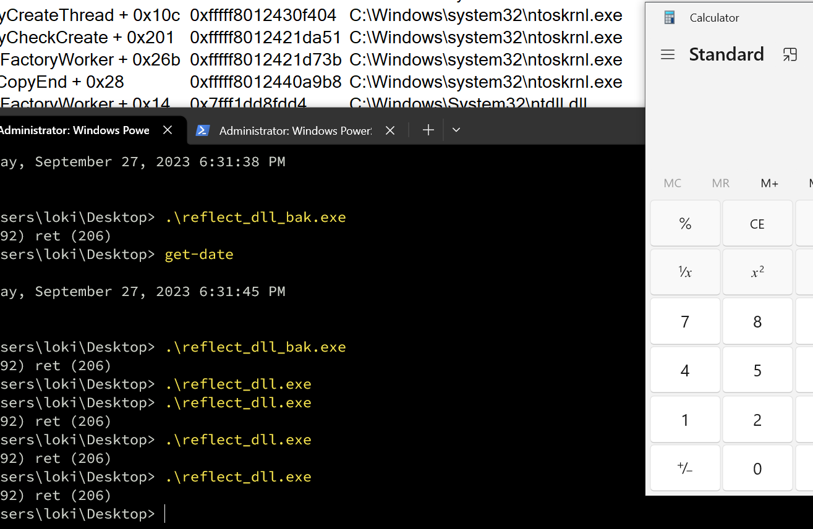
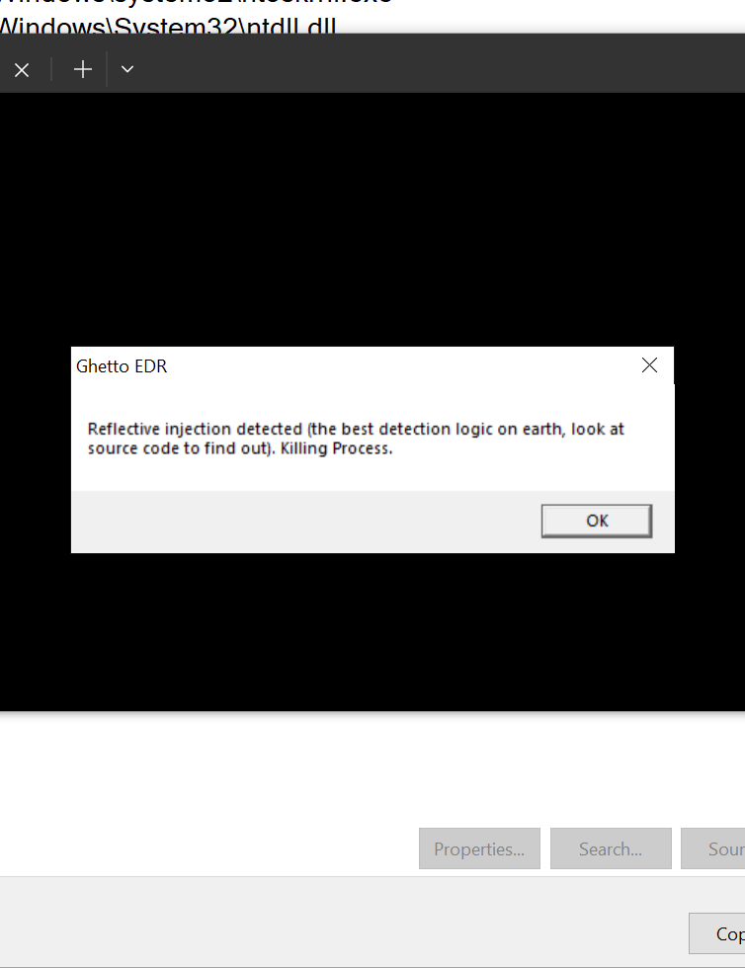
Ghetto EDR

Slide 25
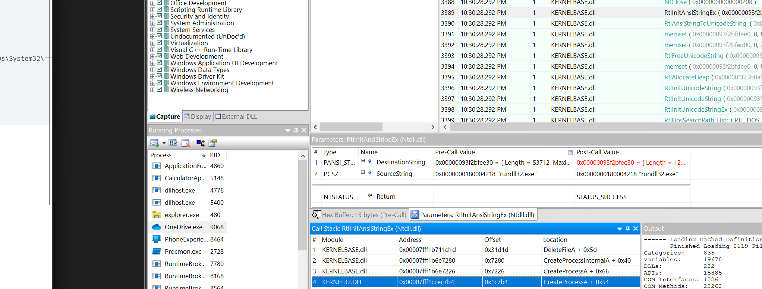
Can a SIEM spot it? Depends

Slide 26
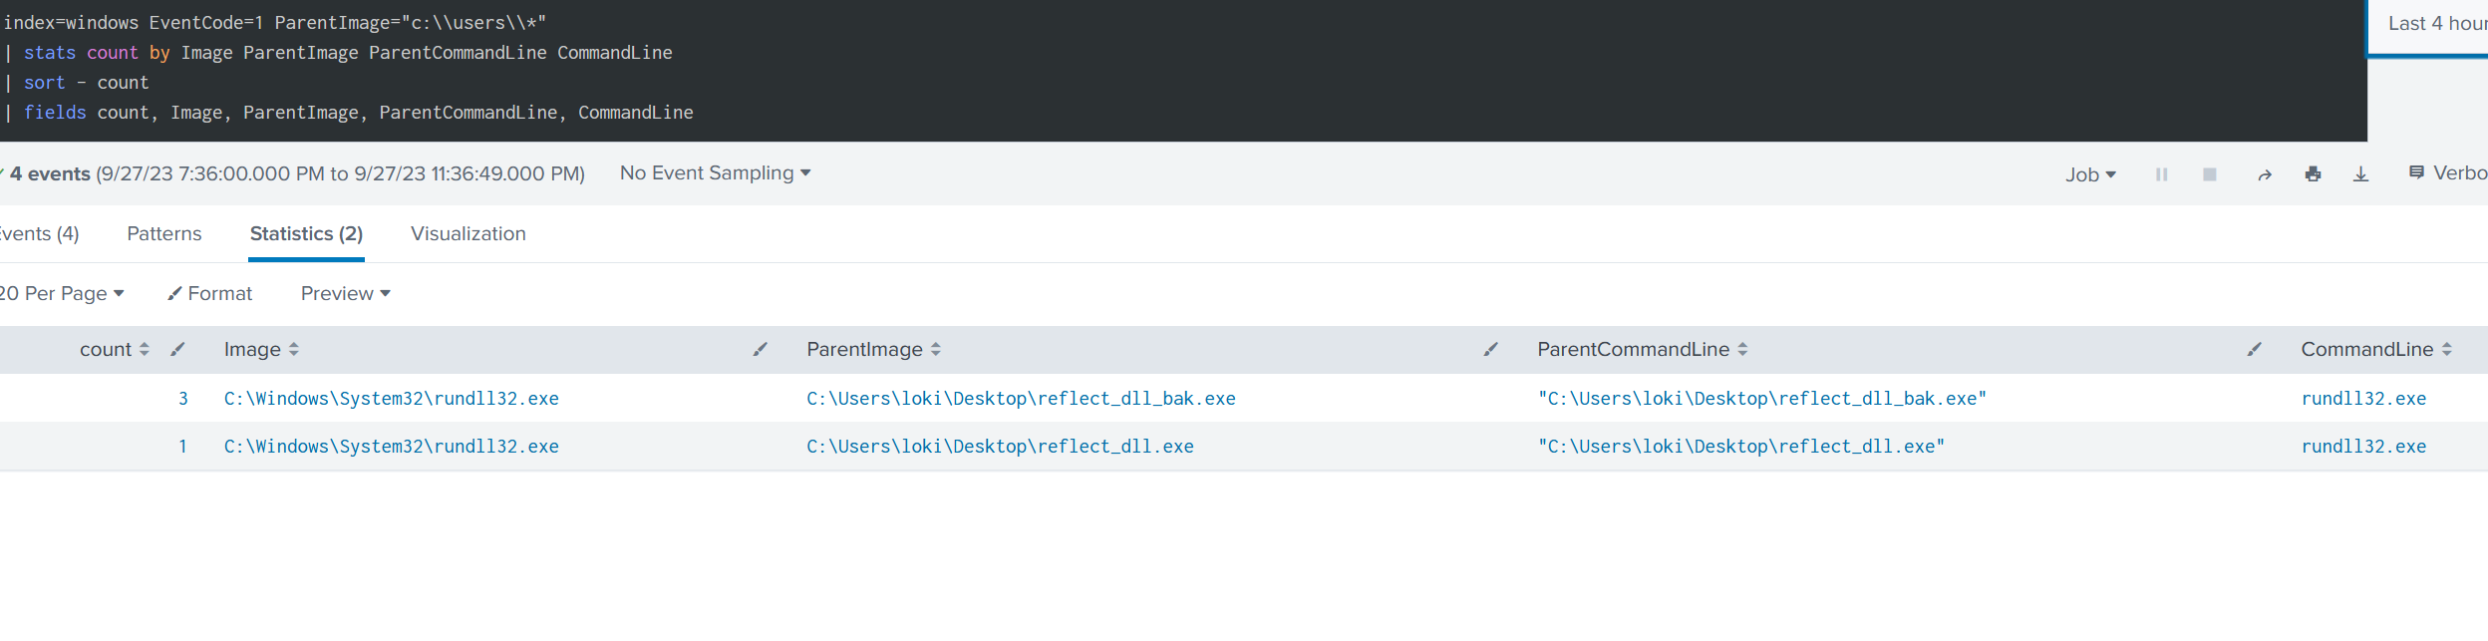
Sometimes we are lucky

Slide 27
Additional Research Resources
https://www.elastic.co/security-labs/upping-the-ante-detecting-in-memory-threats-with-kernel-call-stacks
https://www.ired.team/offensive-security/code-injection-process-injection/reflective-dll-injection
https://defcon.org/html/links/dc-archives/dc-20-archive.html#King
https://github.com/stephenfewer/ReflectiveDLLInjection
https://github.com/papadp/reflective-injection-detection

Slide 28
DLL Injection SetWindowsHookExA

Slide 29
Overview of DLL Injection
Load malicious DLL into programs memory
Get the address of the function to call
Pass the above as parameters into SetWindowsHookEx

Slide 30
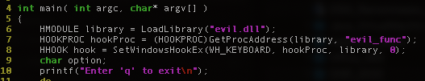
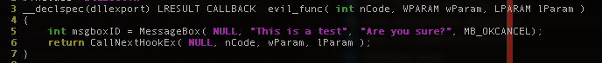
Code of Injection

Slide 31
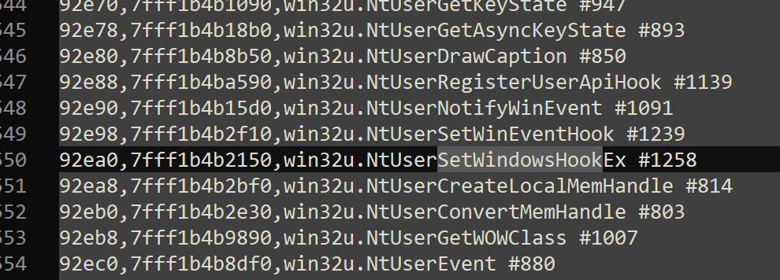
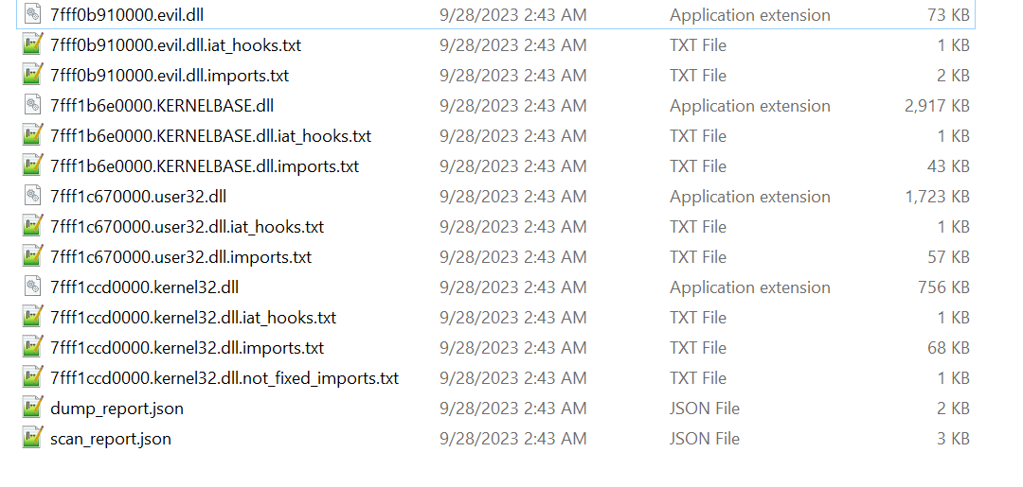
Detection of Injection
Hollow Hunter Arguments
User32.dll Import Table
Dump Files

Slide 32
Thread Queue APC Injection + (Syscall Example)

Slide 33
Overview of Injection
Spawn new Process in suspended state
Allocate memory in remote process
Copy shellcode into remote memory
Use QueueUserAPC to execute memory in remote process
Resume remote process thread to execute shellcode

Slide 34
Code of Injection
Standard
https://github.com/trustedsec/TCS_InjectionTechniques/tree/main/techniques/injectionTechniques/queueuserapc/poc
With Syscalls
https://github.com/trustedsec/TCS_InjectionTechniques/tree/main/techniques/injectionTechniques/syscall_queueuserapc/poc

Slide 35
APIs to monitor
User Space
CreateRemoteThread
WaitForSingleObjects
WaitForMultipleObjectsEx
Process32First
Process32Next
Kernel Space (Device Drivers)
KeInitializeApc
KeInsertQueueApc

Slide 36
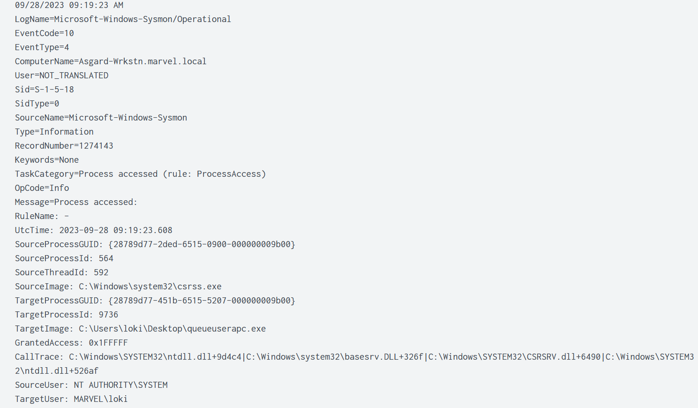
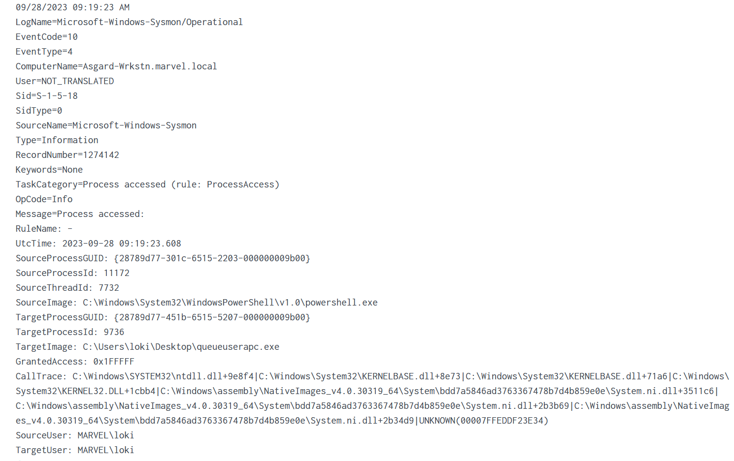
Detection of Injection

Slide 37
Shellcode Injection using Mapping Sections

Slide 38
Overview of Injection
Create a new Memory section with READ|WRITE|EXECUTE permissions
Create a view into the memory section for the local process with READ|WRITE permissions
Open a Handle into a target remote process
Create a view into the memory of the target process with READ|EXECUTE permissions
Copy shellcode into memory section
Execute shellcode by creating a new thread.

Slide 39
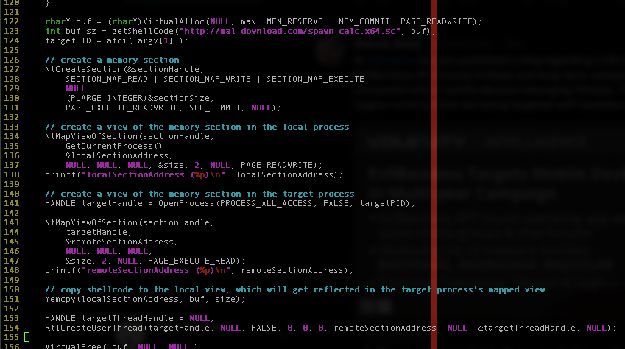
Code of Injection

Slide 40
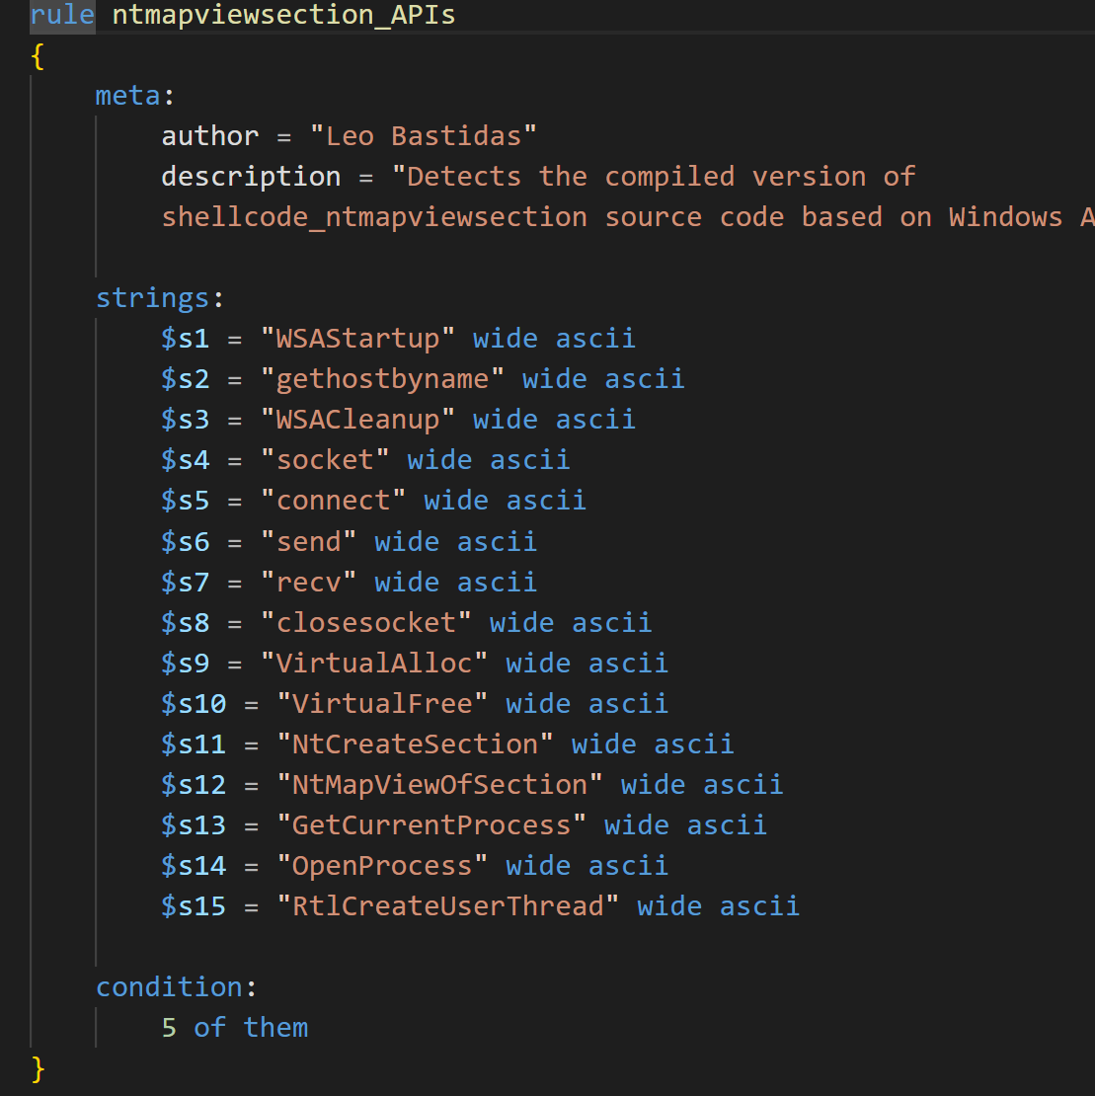
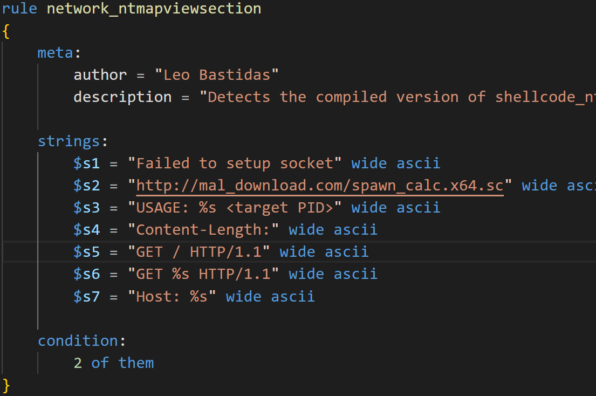
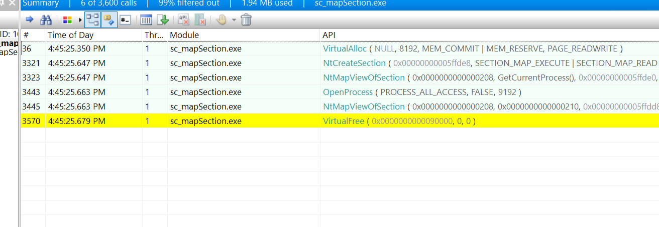
Detection of Injection
Yara rules and API calls

Slide 41
API Hooking + Hooking IAT

Slide 42
Overview of API Hooking
API Hooking Overwriting the function
Identify the location of the function to hook
Copy the first few bytes of the function
Create a method to return to original code
Create the code used to patch the target function
Trampoline to our malicious code
Modify the target functions memory privileges to allow Read|Write
Overwrite target function with Patch
Modify the target functions memory privileges to the original
Call target function

Slide 43
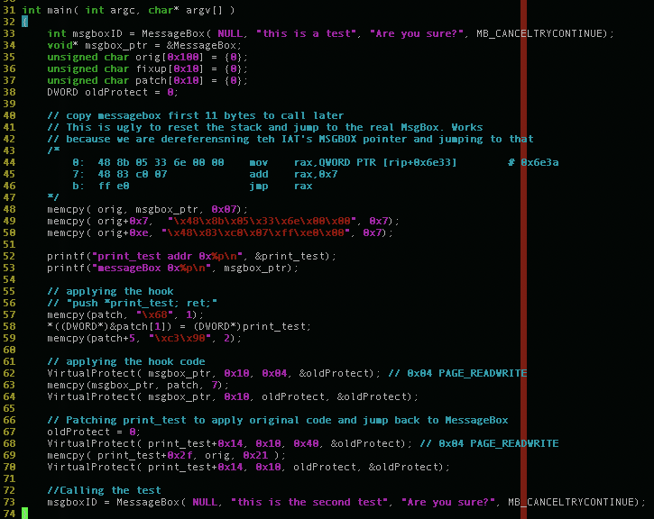
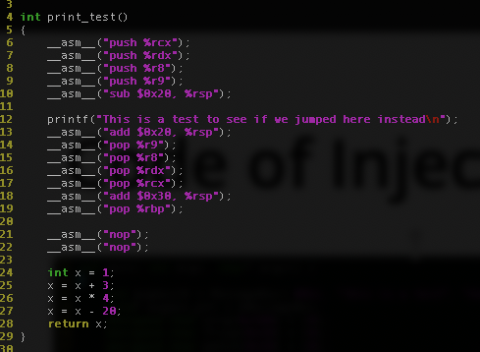
Code of API Hooking

Slide 44
Overview of API Hooking IAT
API Hashing Overwriting the Import Address Table
Load the malicious DLL into the process memory
Parse the target library and function address from the Import Address Table
Overwrite the address stored in the IAT with the address of the malicous function
Call target function.

Slide 45
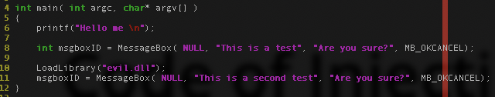
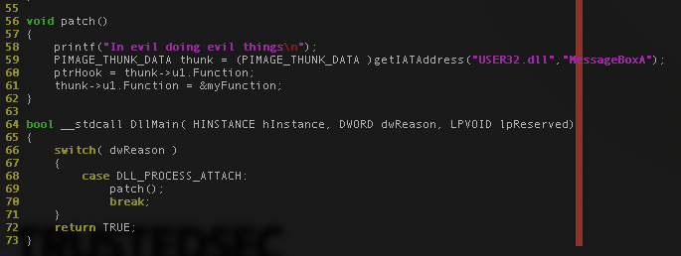
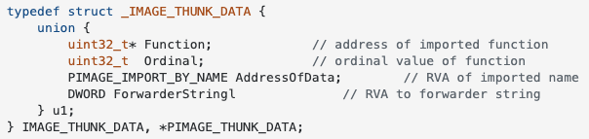
Code of IAT API Hooking

Slide 46
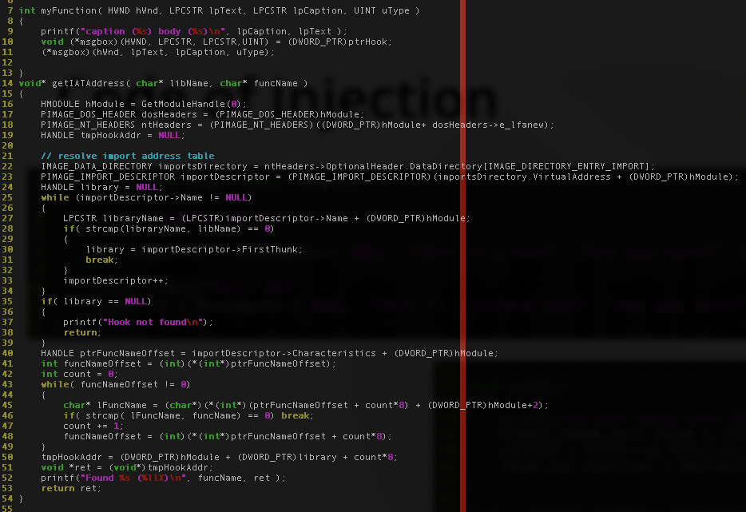

Slide 47
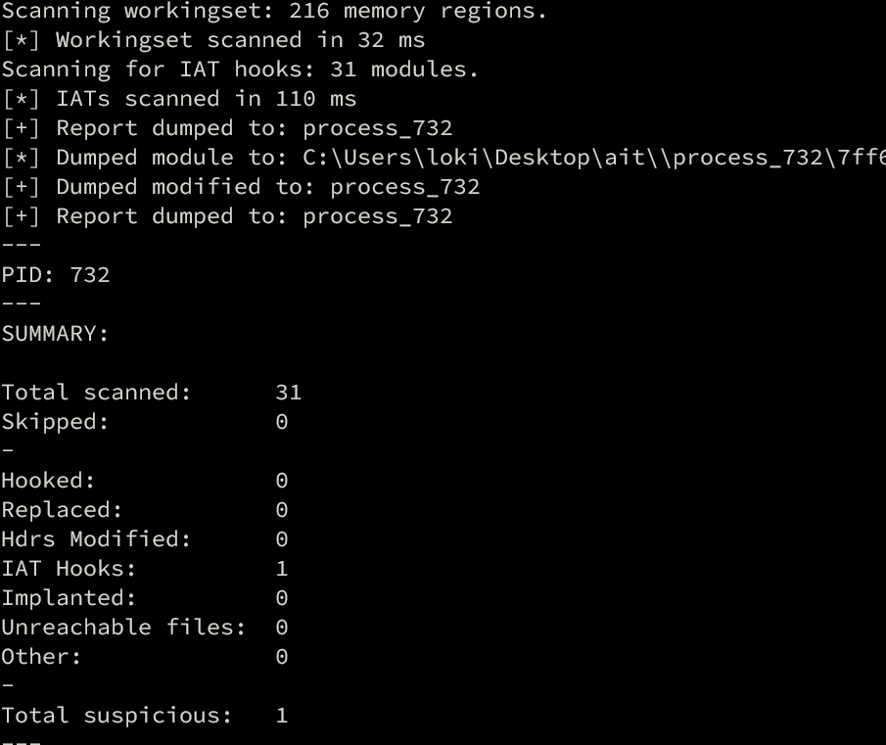
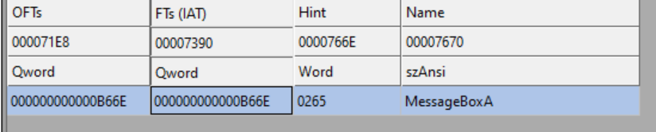
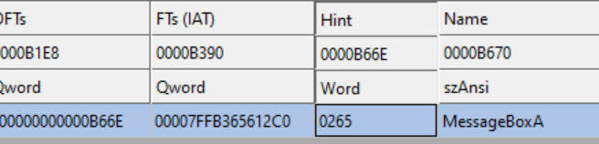
Defenders?
Unpatched
Patched

Slide 48
Additional Research Links
https://github.com/hasherezade/pe-sieve/wiki/4.7.-Scan-for-IAT-Hooks-(iat)
https://github.com/m0n0ph1/IAT-Hooking-Revisited
https://medium.com/@contionmig/hooking-detection-bypasses-63c7877ad217
https://guidedhacking.com/threads/how-to-hook-import-address-table-iat-hooking.13555/
https://www.ired.team/offensive-security/code-injection-process-injection/import-adress-table-iat-hooking

Slide 49
API Hashing

Slide 50
Overview of Injection
Using Hashed values of the Library Name and Function name to load locate their address.
Hiding functionality from analysis.
Parsing the IAT similar to before

Slide 51
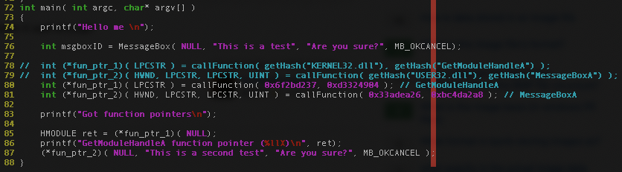
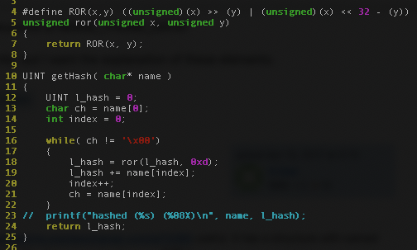
Code of Injection

Slide 52
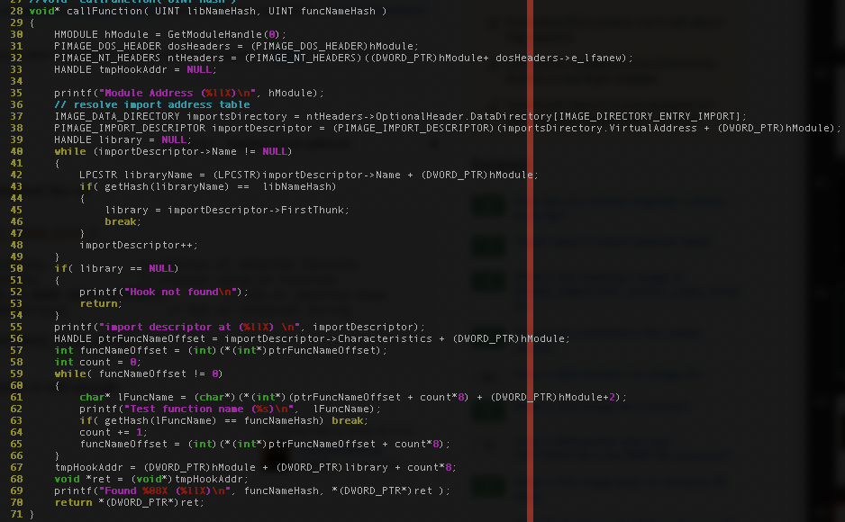

Slide 53
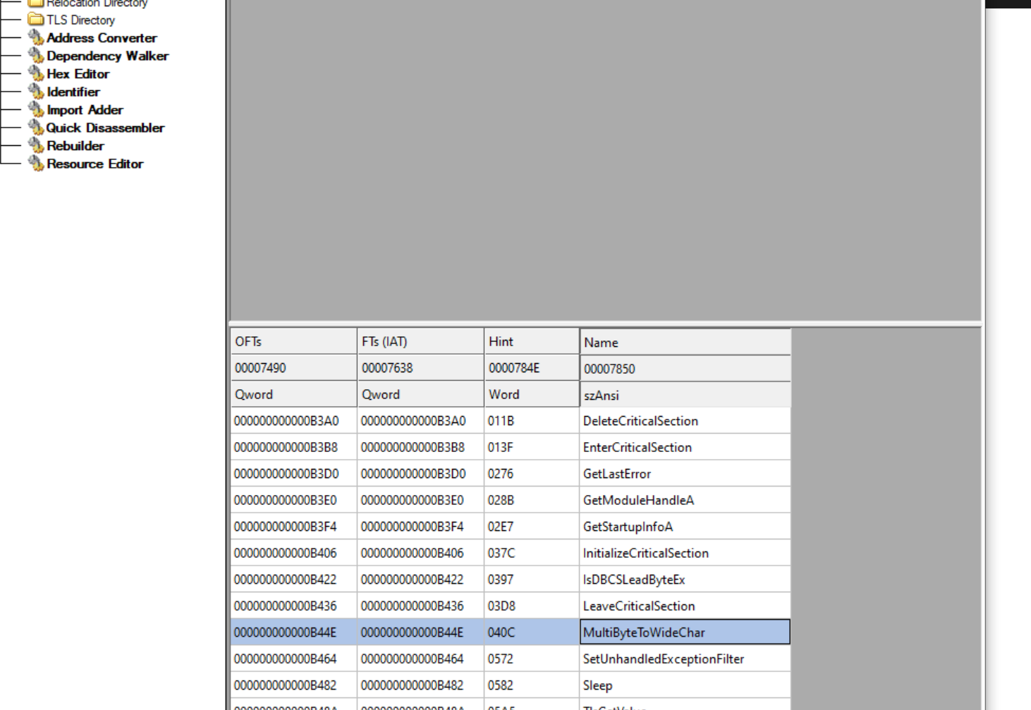
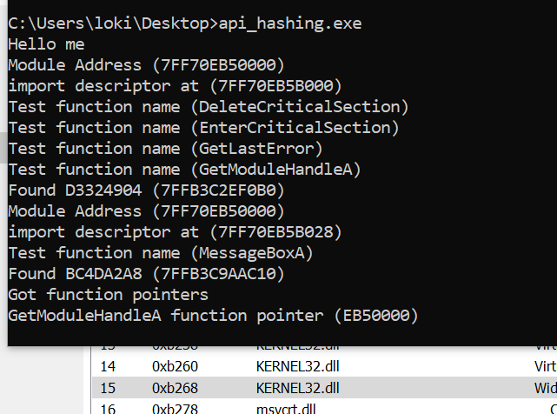
Detection of Injection
Import Directory

Slide 54
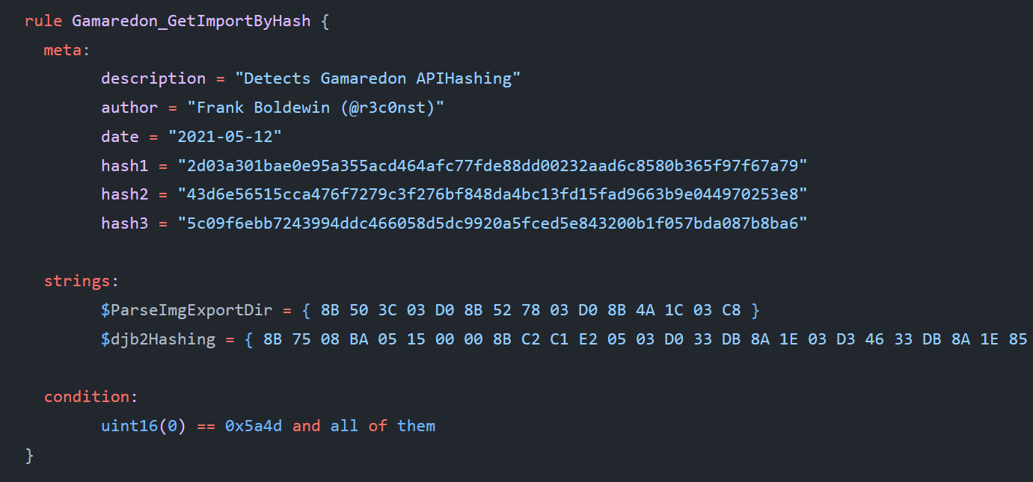
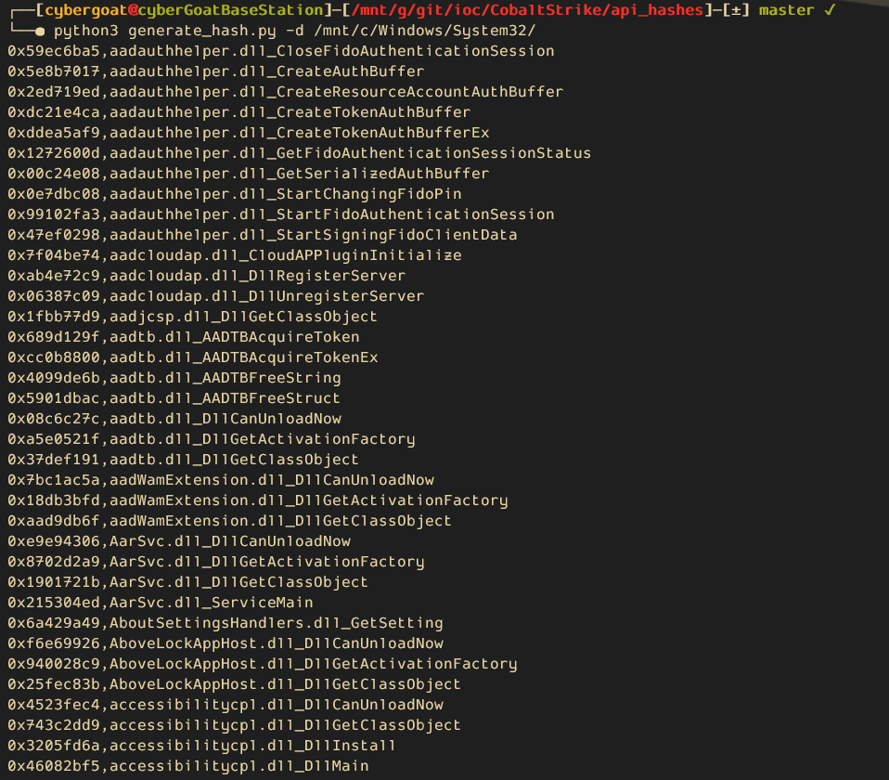
Detection of Injection
https://twitter.com/r3c0nst/status/1392405576131436546?s=20

Slide 55
Additional Defense Resources
https://github.com/Neo23x0/signature-base
https://github.com/tbarabosch/apihash_to_yara
https://github.com/embee-research/Randomise-api-hashes-cobalt-strike
https://www.huntress.com/blog/hackers-no-hashing-randomizing-api-hashes-to-evade-cobalt-strike-shellcode-detection
https://decoded.avast.io/threatintel/decoding-cobalt-strike-understanding-payloads/

